Slide 1

Bank Telemarketing

Slide 2
Predict if the client will subscribe to a term deposit
Abstract -
This project focuses on predicting client subscriptions to term deposits in a Portuguese bank's direct marketing campaigns. By analyzing customer data and employing predictive modeling, we aim to optimize telephonic marketing efforts. Our goal is to identify clients most likely to subscribe, reducing campaign costs and maximizing returns.
This project underscores the potential of data science in enhancing marketing strategies for improved bank profitability.

Slide 3
Business Problem
Objective -
The primary objective of this project is to develop a predictive model for a Portuguese bank's direct marketing campaigns with the aim of identifying clients who are most likely to subscribe to term deposits. Predict customers' responses to future marketing campaigns & increase the effectiveness of the bank's telemarketing campaign.
Challenges -
Imbalanced classes in the target variable (subscribed vs. not subscribed) (5000 vs 40000)can lead to biased model predictions. Addressing class imbalance is essential for model performance. Creating relevant features from the available data can be challenging. Selecting the right set of features that contribute to prediction accuracy is vital.
Real World Impact -
By accurately predicting which clients are more likely to subscribe to term deposits, the bank can tailor its marketing efforts more effectively. This translates to reduced marketing costs and improved allocation of resources. The project's insights can lead to an increase in term deposit subscriptions, contributing to a growth in the bank's revenue. It also helps in achieving a higher return on investment for marketing initiatives.

Slide 4
Dataset
Datasets-
The dataset is about the direct phone call marketing campaigns, which aim to promote term deposits among existing customers, by a Portuguese banking institution from May 2008 to November 2010. There are 45,212 observations in the dataset, with no missing values. Each represents an existing customer that the bank reached via phone calls.
Data Fields-
1 - age (numeric)
2 - job : type of job (categorical:
"admin.","unknown","unemployed","management","housemaid","entrepreneur","student","blue-collar","self-employed","retired","technician","services")
3 - marital : marital status (categorical: "married","divorced","single";)
4 - education (categorical: "unknown","secondary","primary","tertiary")
5 - default: has credit in default? (binary: "yes","no")

Slide 5
Data Fields -
6 - balance: average yearly balance, in euros (numeric)
7 - housing: has housing loan? (binary: "yes","no")
8 - loan: has personal loan? (binary: "yes","no")
# related with the last contact of the current campaign:
9 - contact: contact communication type (categorical:"unknown","telephone","cellular")
10 - day: last contact day of the month (numeric)
11 - month: last contact month of year (categorical: "jan", "feb", "mar",…, "nov", "dec")
12 - duration: last contact duration, in seconds (numeric)# other attributes:
13 - campaign: number of contacts performed during this campaign and for this client (numeric, includes last contact)

Slide 6
Data Fields-
14 - pdays: number of days that passed by after the client was last
contacted from a previous campaign (numeric, -1 means client was not previously contacted)
15 - previous: number of contacts performed before this campaign and
for this client (numeric)
16 - poutcome: outcome of the previous marketing campaign (categorical: "unknown","other","failure","success")
Output variable (desired target):
17 - y - has the client subscribed a term deposit? (binary: "yes","no")

Slide 7
Real world challenges and constraints
Constraints -
Real world challenges and constraints can pose significant obstacles when trying to address employee attrition. Some of the common constraints include limited data volume, class Imbalance and time constraints.
Requirement for Solution -
Given the relatively limited dataset available, it is essential to maximize the utility of the existing data, for example feature engineering. Address the class imbalance issue to ensure that the predictive model does not exhibit a bias toward the majority class (negative instances of term deposit subscriptions), for example oversampling techniques. Accomplish the project's objectives within the defined project timeline, considering potential time constraints.
Solution Approach and Problem Type -
This problem type is very similar to Classification with imbalanced data and there are multiple ways in which these are handled to name a few are :
SMOTE
XGboost Classifier

Slide 8
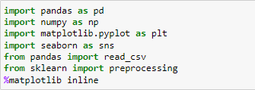
Libraries
We have used multiple libraries to perform EDA -
EDA
We will start with understanding of the data.
Finding NA and Null values -
We found no Null or NA values across the data set
Understanding Data types of different columns -
We found all the columns to have appropriate data types

Slide 9
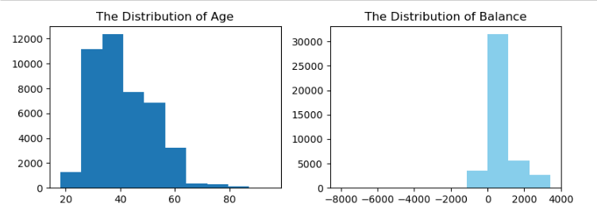
Visualization
Visualization of Age and Balance
Age: In its telemarketing campaigns, clients called by the bank have an extensive age range, from 18 to 85 years old. However, a majority of customers called is in the age of 30s and 40s.
Balance: After dropping outliers in balance, the range of balance is still massive, the maximum people have balance between (0 to 1000)

Slide 10
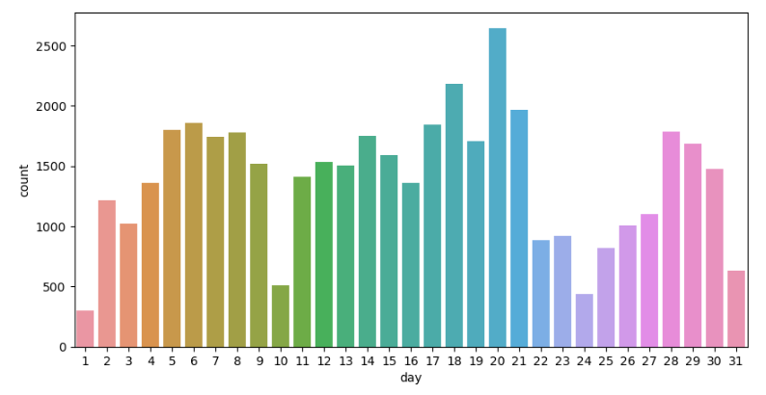
Visualization of Day

Slide 11
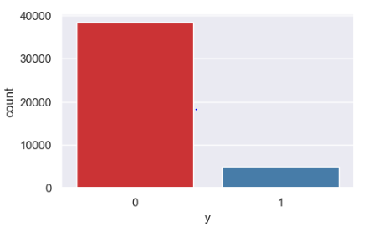
Visualization of Response
From the Visualization of target column, we see that data is imbalanced with No has 38000 and Yes has 5200.

Slide 12
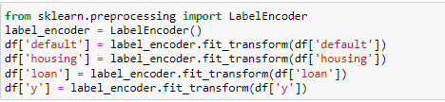
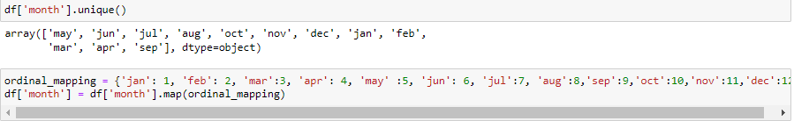
Now, we will convert the Categorical data into Numerical with the help of Label Encoding -
We will convert the Month Column to numeric data with the help of mapping-
Applying one-hot encoding for columns with values more than 2.

Slide 13
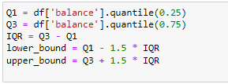
Handling Outliers in all columns –
We checked for outliers using “describe” function and “box plot”. We had outliers in all products columns only rest all columns had decent distribution so we handled it using IQR method which is one of the most reliable method to handle outliers.
Here upper bound limit was 3437.5 so we replaced values greater than it with median value of this column.

Slide 14
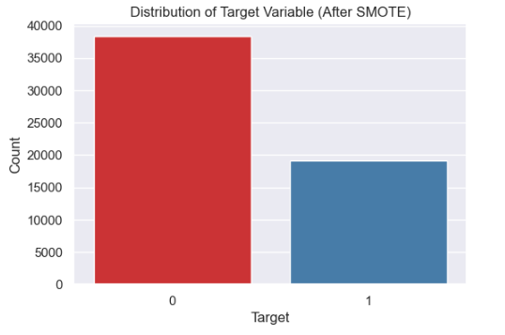
SMOTE
SMOTE method is used when we have unbalanced data in our target column. We had data in response column in the ratio of 90:10 where 90% value was 0 and only 10% value was 1. Using smote method we created dummy values for response 1, which helped to balance the data.

Slide 15
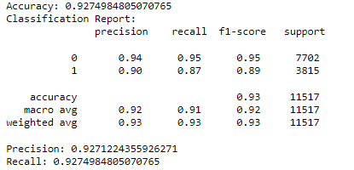
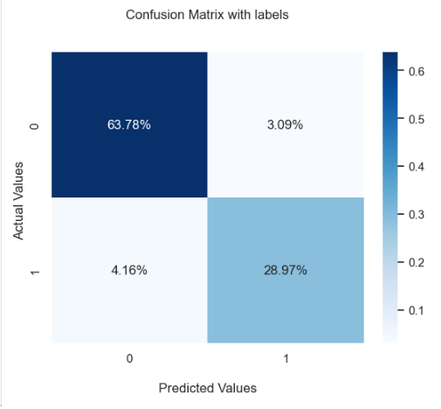
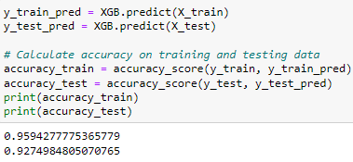
XGBoost Classifier Model
We divide the data into X_train,Y_train, X_test, Y_test to fit the model and also test the model on test data. We have got very good output from the XGBoost Classifier Model. We achieved Precision Score of 0.92 and Recall Score of 0.92. It also has train accuracy of 95% and test accuracy of 92%.

Slide 16
Conculision
In this project, we leveraged the power of the XGBoost classifier to address a complex and critical machine learning task. XGBoost, renowned for its efficiency and predictive prowess, proved to be an invaluable asset in our pursuit of accurate and robust predictive models.
Our journey with XGBoost began with data preprocessing and feature engineering, where we prepared the dataset to extract meaningful insights and patterns. The ability of XGBoost to handle missing values seamlessly and accommodate various types of features greatly expedited this phase.
XGBoost has best accuracy amongst all other models.

Slide 17
Thank you

